Slide 1
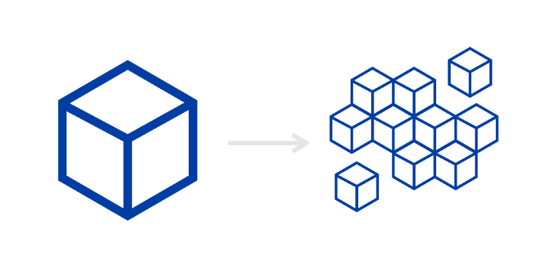



How to message in the cloud
Introduction to Message oriented middleware
+
microservices
rabbitMQ
Kafka
nats.io
Notes:
Hi all,
Today i will present a talk called “Life of a packet in k8s: from linux networking to service mesh”
The talk i scheduled to be about x minutes
T

Slide 2

Objectives
Learn basic concepts in distributed systems and messaging
Learn in high level about Kafka,RabbitMQ and Nats.io and understand when to use each
Notes:
Change mental model -> high level concept

Slide 3
Presentation overview
Overview of distributed systems and their characteristics
Overview of different messaging patterns in distributed systems
RPC vs shared resources
Synchronous vs asynchronous
Orchestration vs choreography
Overview of message oriented middleware(MOM)
What are they
Messaging schemas
Overview of popular message oriented middleware
Kafka
RabbitMQ
NATS
Evaluate key difference between the popular middlewares

Slide 4
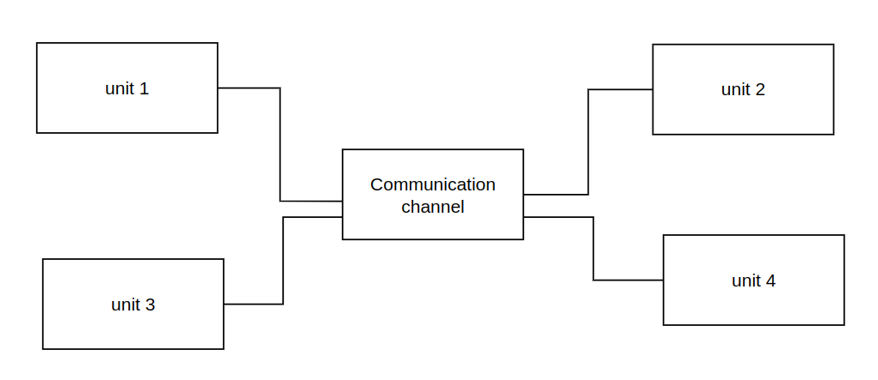
Distributed system
A collection of components located on different networked computers that communicate and coordinate their task by passing messaging to one another via a network to achieve a common goal
Notes:
Before we begin talking about the main point of the talk i think a small clarification of basic concepts is important

Slide 5
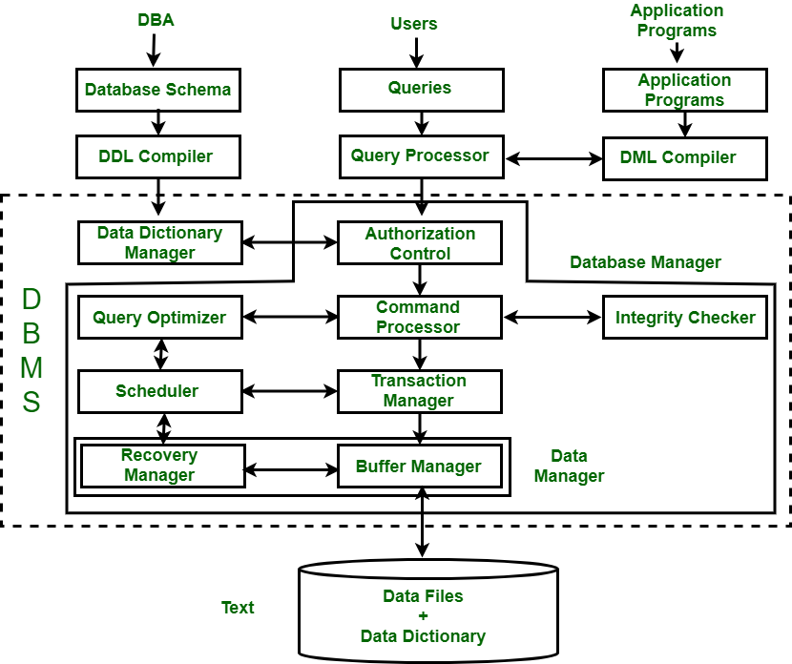
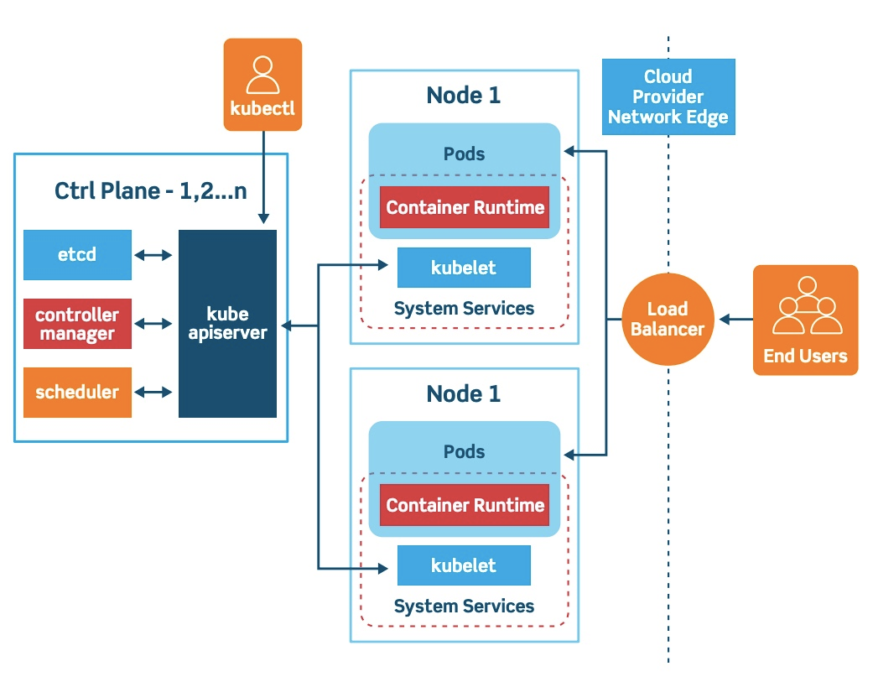
Distributed system examples
Process running on a single machine for example database management systems
Components can be physical machines spread across a network for example kubernetes
Notes:
Before we begin talking about the main point of the talk i think a small clarification of basic concepts is important

Slide 6
Characteristics of Distributed Systems:
Heterogeneity
Distributed systems components differ by (Networks,Computer hardware,Operating systems,Programming languages). Distributed system should mask those differences by common interfaces(middleware).
Openness
Distributed systems should be easy to extend and improve by using detailed interfaces
Transparency
Distributed systems should be perceived by users and application programmers as a whole rather than as a collection of cooperating components.
Scalabilty
Distributed systems should be designed to not be changed when the scale of the system changes,i.e the horizontal scale(increase the number of components) and Vertical scale( increase the resources of the system)
Concurrency
Distributed systems components execute in a concurrent manner to complete a task. Components access and update shared resources (e.g. variables, databases, device drivers) which can produce unexpected behaviour when concurrent updates are not coordinated.
Notes:
Before we begin talking about the main point of the talk i think a small clarification of basic concepts is important

Slide 7
Characteristics of Distributed Systems:
Failure handling
Distributed systems components can fail.Distributed systems must maintain availability even at low levels of hardware/software/network reliability.Such systems must be fault tolerant(recoverable,redundant
Security
Distributed systems components communicate using messaging channels. Security is required for concealing messaging(security and privacy) , authentication and more
Notes:
Before we begin talking about the main point of the talk i think a small clarification of basic concepts is important

Slide 8
Messaging patterns used in distributed systems
Distributed system have multiple communication patterns between them.
The following patterns will be explained:
RPC versus shared resources
Synchronous versus asynchronous
Orchestration versus choreography
Notes:
Before we begin talking about the main point of the talk i think a small clarification of basic concepts is important

Slide 9
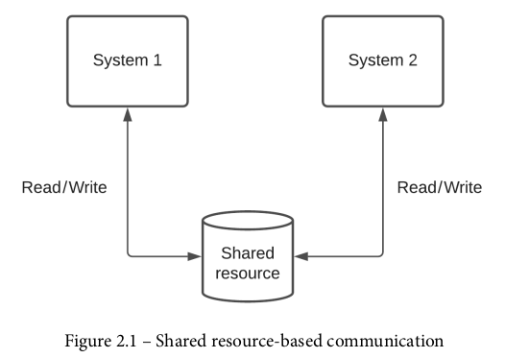
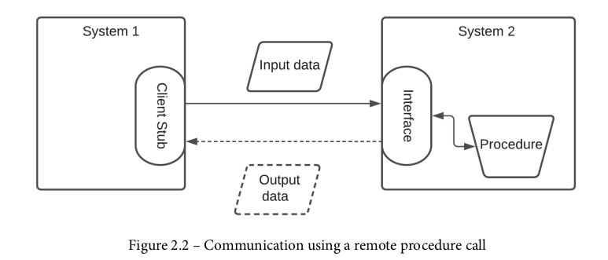
RPC versus shared resources
Notes:
Before we begin talking about the main point of the talk i think a small clarification of basic concepts is important

Slide 10
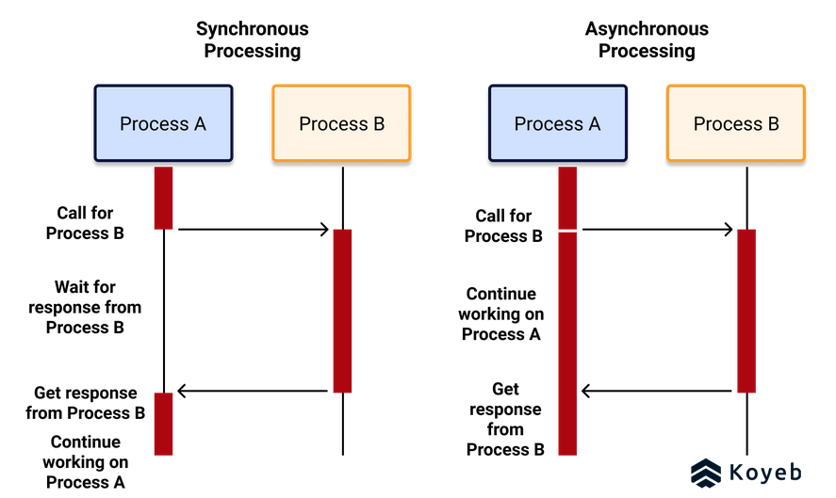
Synchronous versus asynchronous
Notes:
Before we begin talking about the main point of the talk i think a small clarification of basic concepts is important

Slide 11
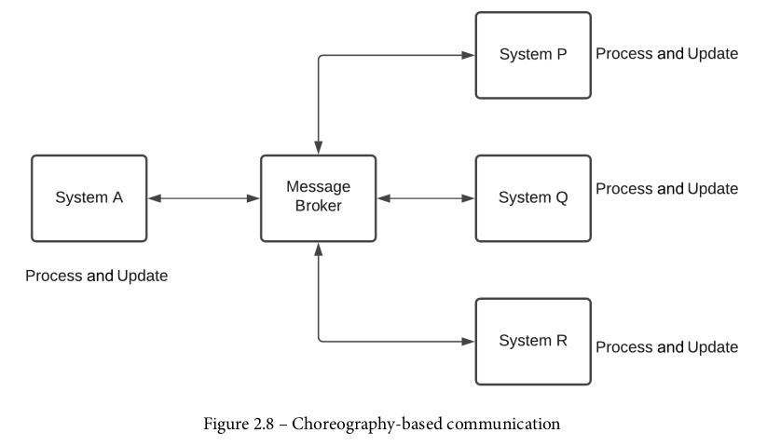
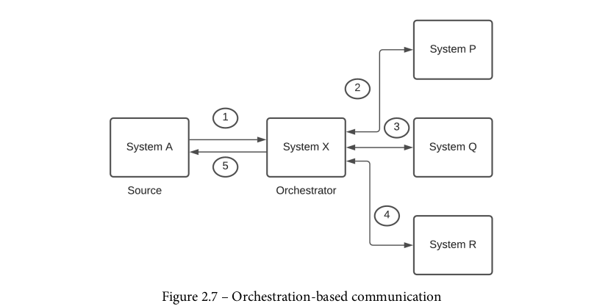


Orchestration versus choreography
Notes:
Before we begin talking about the main point of the talk i think a small clarification of basic concepts is important

Slide 12
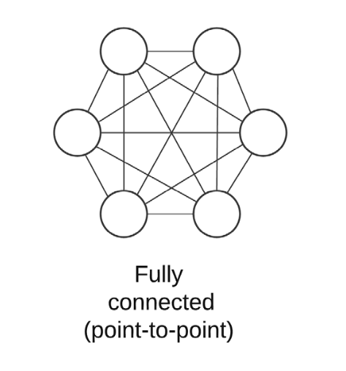
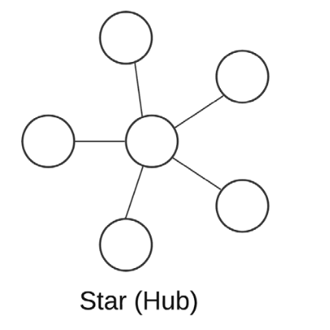
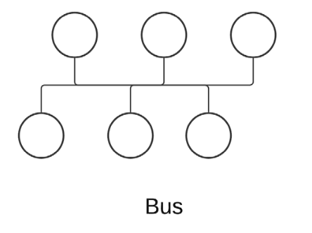
Distributed systems networking architectures
There are many different architectures for distributed system each with its own use case and advantage
Notes:
Before we begin talking about the main point of the talk i think a small clarification of basic concepts is important

Slide 13
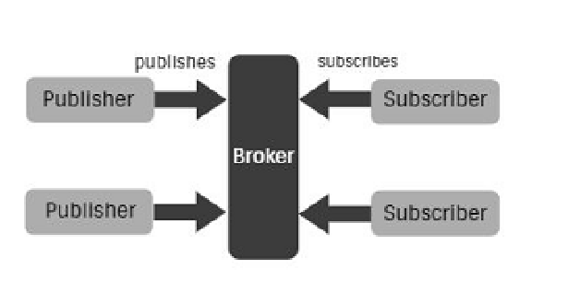
Message oriented middleware(MOM)
Distributed systems contain many components written in different programing languages running on different hardware and operating systems(heterogeneous).
Middleware is a logical abstraction between heterogeneous apps that allows apps to communicate in spite of the differences described above
Middleware simplify network topology in a distributed systems(service bus)
Notes:
Before we begin talking about the main point of the talk i think a small clarification of basic concepts is important

Slide 14
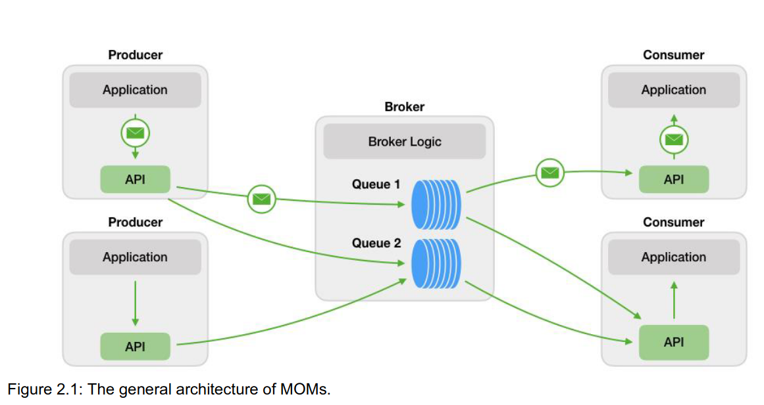
General architecture of message-oriented middleware
Producers: processes that send data
Consumers: processes that recieve data
Broker: containing routing logic and queues
Messages: the data entries that is being exchanged between the applications are called messages.
Notes:
Before we begin talking about the main point of the talk i think a small clarification of basic concepts is important

Slide 15
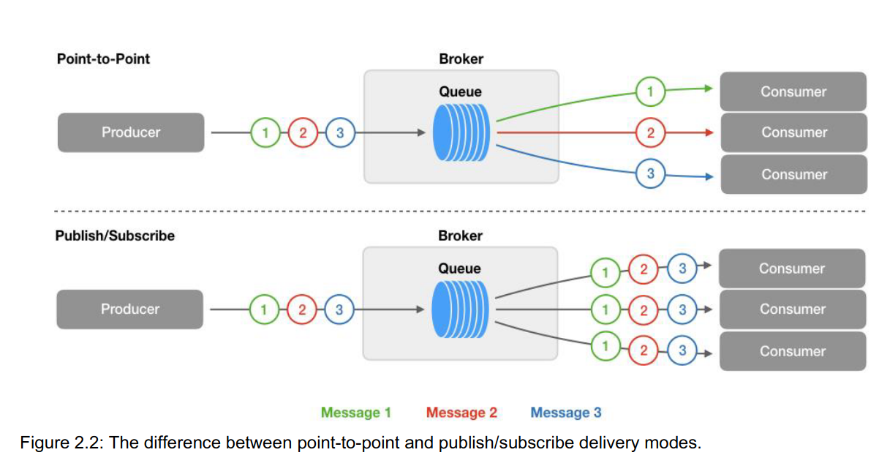
Message-oriented middleware delivery modes
Point-to-point (Queue): Point-to-point delivery is when a producer sends a message and only one consumer receives it e.g. one-to-one communication.
Publish/Subscribe: In this delivery mode consumers subscribe to a topic.When a producer sends a message to the topic, a copy of the message gets forwarded to all consumers that have subscribed to that topic e.g. one-to-many communication.
Notes:
Before we begin talking about the main point of the talk i think a small clarification of basic concepts is important

Slide 16
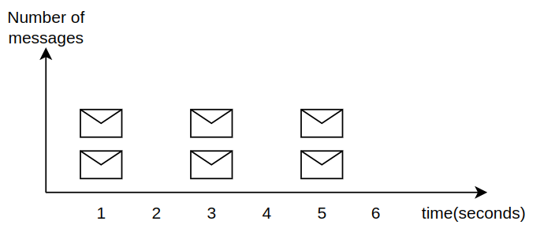
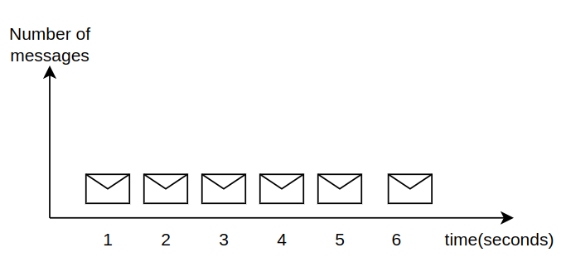
Message-oriented middleware message characteristics: performance
Performance in MOM is exclusively defined by latency and throughput
Latency: Latency is the time it takes for a message to travel from the producer to the consumer.
Throughput: Throughput is generally defined as the amount of data that are transferred in a given time.
Latency:?
Throughput:?
Latency:?
Throughput:?
Notes:
In the context of MOMs persistence refers to persistent storage of the queue and its
messages. Some MOMs have the ability to store the entire queue in persistent
storage, while others just keep the queue in main memory. Persistent storage can
be important for some use cases. If the broker server crashes with the queue stored
in memory, all the messages are lost which can be undesirable if many messages
are stored in the queue. Even in applications that accept some message loss, losing
the whole queue may be unacceptable. Some MOMs also support both storage
types and the users can choose if they want to keep the messages in memory or
store them on disk.

Slide 17
Message-oriented middleware message characteristics: Delivery schematics
At most once : when a MOM is using at-most-once delivery schematics it does not guarantee that all messages will arrive at the consumer, messages can get lost during failures. Lowest latency
At least once: When a MOM is using exactly-once delivery schematics all messages are guaranteed to be delivered to the consumer without any duplicates. This requires a complicated acknowledgement and transaction scheme from the producer to the consumer.Medium latency
Exactly once: when a MOM is using at-least-once delivery schematic all the messages are guaranteed to be delivered to the consumer. This is achieved by a two-step acknowledgement scheme. The broker acknowledges all messages it receives from the producer and the consumer acknowledges all messages it receives from the broker.Highest latency
messages<=1
1<=messages
1<=messages<=1

Slide 18
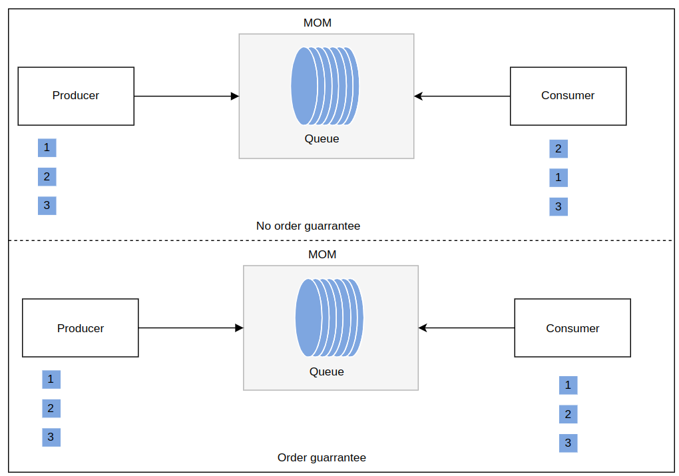
Message-oriented middleware message characteristics: Message ordering
Some MOM guarantee message arrival
Some MOM do not guarantee message arrival order
Notes:
In the context of MOMs persistence refers to persistent storage of the queue and its
messages. Some MOMs have the ability to store the entire queue in persistent
storage, while others just keep the queue in main memory. Persistent storage can
be important for some use cases. If the broker server crashes with the queue stored
in memory, all the messages are lost which can be undesirable if many messages
are stored in the queue. Even in applications that accept some message loss, losing
the whole queue may be unacceptable. Some MOMs also support both storage
types and the users can choose if they want to keep the messages in memory or
store them on disk.

Slide 19
Message-oriented middleware message characteristics: Persistence
Persistent storage of the queue and its messages
Some MOM can store the entire queue in persistent storage
Some MOM can only store the entire queue in main memory
Some message can store the in both memory
It is important to know the relationship between message guarantees and performance.
Message guarantees often come at the cost of performance because it entails additional overhead. For example, going from at-most-once to at-least-once
Message ordering is another guarantee that consumes resources. Ordering requires additional processing steps to sort messages in the broker
Notes:
In the context of MOMs persistence refers to persistent storage of the queue and its
messages. Some MOMs have the ability to store the entire queue in persistent
storage, while others just keep the queue in main memory. Persistent storage can
be important for some use cases. If the broker server crashes with the queue stored
in memory, all the messages are lost which can be undesirable if many messages
are stored in the queue. Even in applications that accept some message loss, losing
the whole queue may be unacceptable. Some MOMs also support both storage
types and the users can choose if they want to keep the messages in memory or
store them on disk.

Slide 20
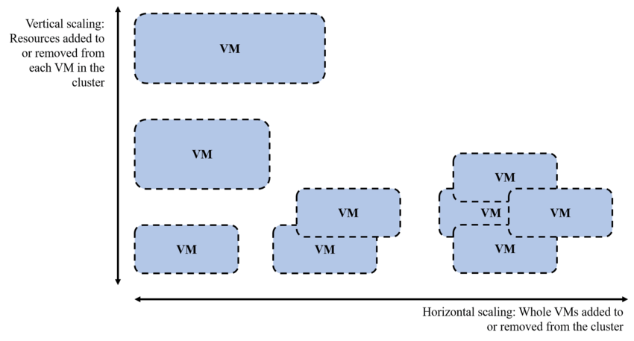
Message-oriented middleware message characteristics: Scalability
Sometimes distributed system need to increase their workload
MOM are built to support both both horizontal and vertical scaling
Therefore,some MOM allow clustering modes where replicas coordinate as one message broker to support increase in workload
Notes:
In the context of MOMs persistence refers to persistent storage of the queue and its
messages. Some MOMs have the ability to store the entire queue in persistent
storage, while others just keep the queue in main memory. Persistent storage can
be important for some use cases. If the broker server crashes with the queue stored
in memory, all the messages are lost which can be undesirable if many messages
are stored in the queue. Even in applications that accept some message loss, losing
the whole queue may be unacceptable. Some MOMs also support both storage
types and the users can choose if they want to keep the messages in memory or
store them on disk.

Slide 21

Review question
GetTaxi is a company that allows people to match with tax drivers on demand,right away
The business wants the following capabilities:
The user should match with a close by driver
The pricing should “surge” if the number of drivers are low or the number of users is high
All the position data before and during the ride should be stored in an analytics store so that the cost can be computed accurately
How would you implement this using message broker?

Slide 22
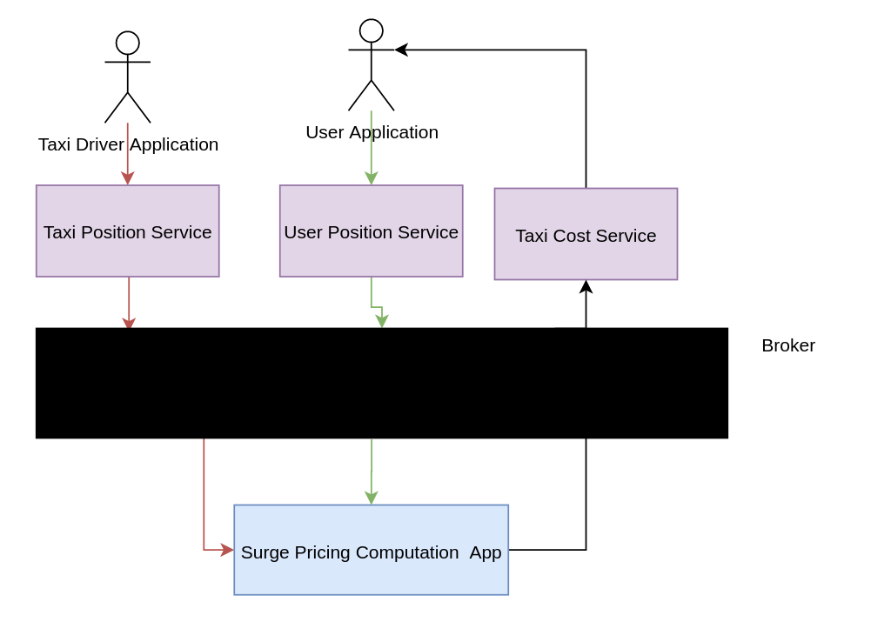
Review question solution

Slide 23




Kafka
https://kafka.apache.org/
Kafka was written in scala.
Open sourced by linkedin in 2011 and as of today is maintained by Confluent,IBM,Cloudera
Licensed under the Apache 2
The project had been stared :23.4k times and forked 12k times
Used by companies such as: IBM,Paypal,Netflix,airbnb

Slide 24
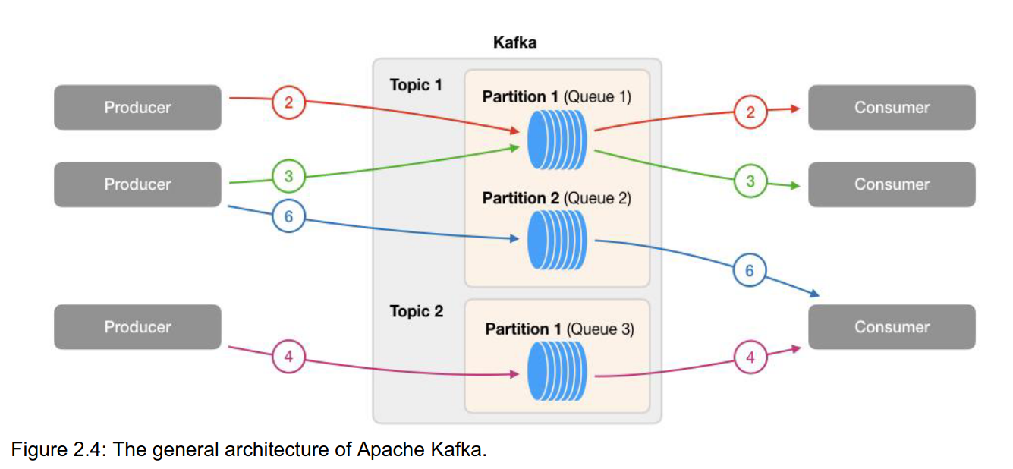
Kafka architecture

Slide 25
Kafka architecture
Topics
Messages in kafka between producers and consumers are sent using data streams.
Kafka can have multiple data streams.
Data streams are not bound by a particular format
A particular data stream in kafka is called topic
Topics behave like queues

Slide 26
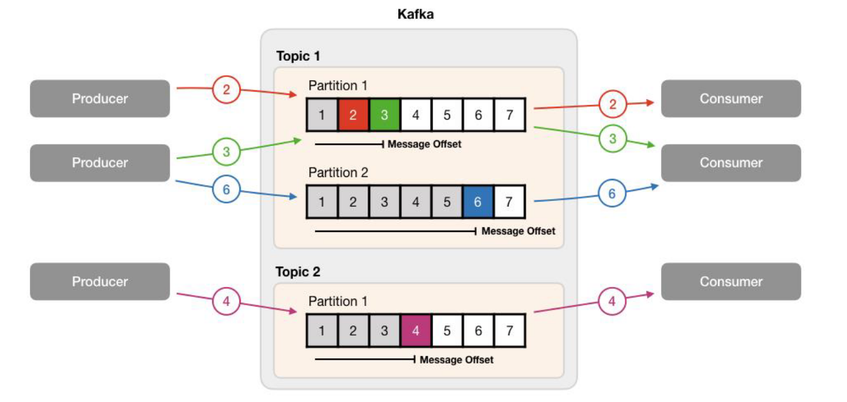
Kafka architecture
Topics are split into partitions
Messages within each partition are ordered
Each message within a partition gets an incremental id,called offset
When a message is sent to to a partition it is assigned an offset.
Offsets allow to keep track of message ordering within the partition .
Offset are used by consumers to keep tract which message it has consumed
Once data is written to a partition it cannot be changed
Data is kept for limited time
Notes:
Talk about sequential data access

Slide 27
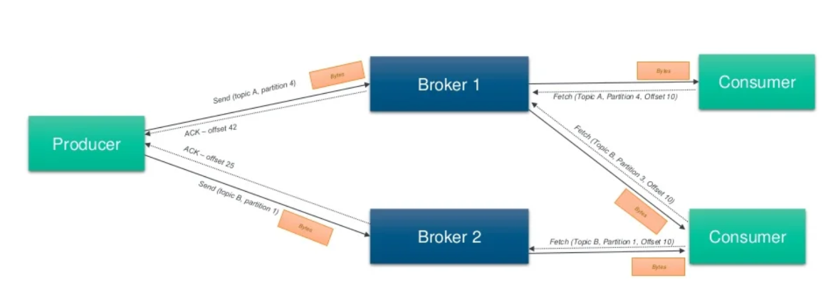
Kafka architecture
Brokers
Kafka runs as a cluster of brokers
Each broker contains certain topic partitions
Each brokers manages data replication, topic/partition management, offset management.
Brokers can span multiple data centers

Slide 28
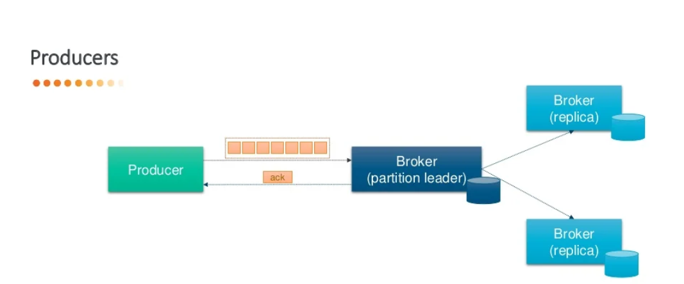
Kafka architecture
Producers
They write data to topics
Producers decide which partition to write to
Producers can send a batch of messages

Slide 29
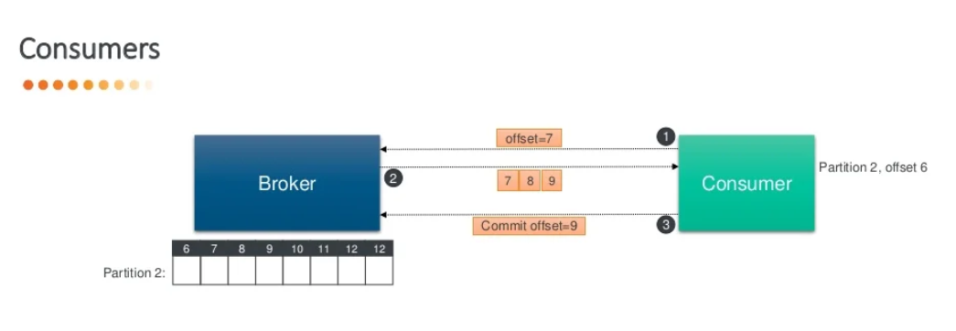
Kafka architecture: Consumers
Consumers
Consumers read data from a topic
Consumers control what offset to read from
Consumers can receive batched or compressed data\

Slide 30
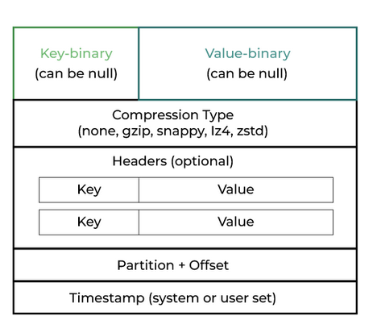
Kafka messages
Messages are created by producers
Messages are sent as binary over tcp
Messages can be compressed
Messages can be at most 1 MB

Slide 31
Kafka message delivery models
There are 3 delivery semantics in kafka :
At least once
Offsets are committed after message is processed
If the processing goes wrong,message will be read again
Messages might have duplicates
At most once:
Offsets are committed as message is received
Messages might be lost
Exactly once:
Messages are committed twice(after message is received and after message is processed)

Slide 32
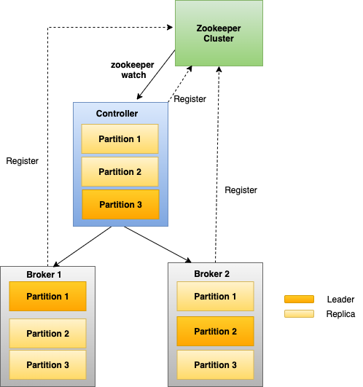
Kafka cluster mode
Kafka is natively built with cluster mode
Cluster mode consistent of a master broker(control) and slave brokers
Master is chosen per topic

Slide 33
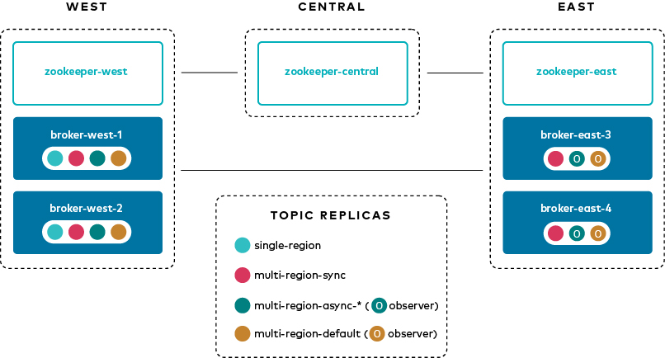
Kafka Multi clustering
Kafka does not natively supports multi cluster and requires plugins
Kafka allows only a mode called cross-cluster mirroring
Cross cluster mirroring is just copying of data from one cluster to another

Slide 34
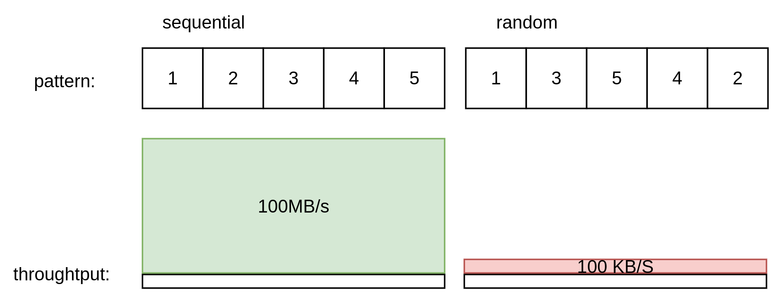
Why is Kafka fast ?
Reason 1: sequential access pattern
Kafka utilises sequential data access and not random access
Sequential data is faster in orders of magnitudes compares to random access

Slide 35
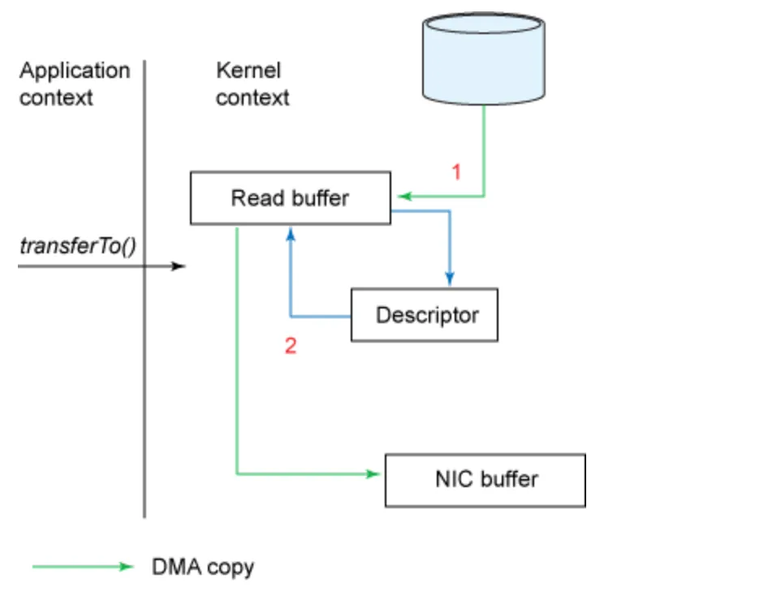
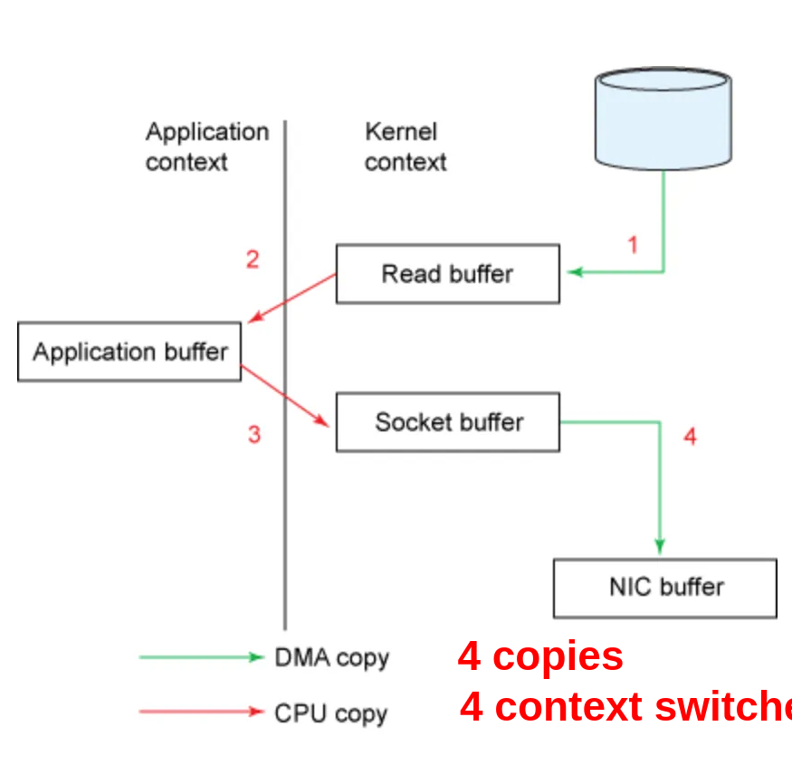
Why is Kafka fast ?
Reason 2: zero copy principle
Kafka utilises zero copy principle to improve performance
Using the transferto() function avaliable by later versions of java file contents can be copied into a kernel buffer by the DMA engine.
Sequential data is faster in orders of magnitudes compared to random access

Slide 36
Review question
GetTaxi is a company that allows people to match with tax drivers on demand,right away
The business wants the following capabilities:
The user should match with a close by driver
The pricing should “surge” if the number of drivers are low or the number of users is high
All the position data before and during the ride should be stored in an analytics store so that the cost can be computed accurately
How would you implement this using Kafka?

Slide 37
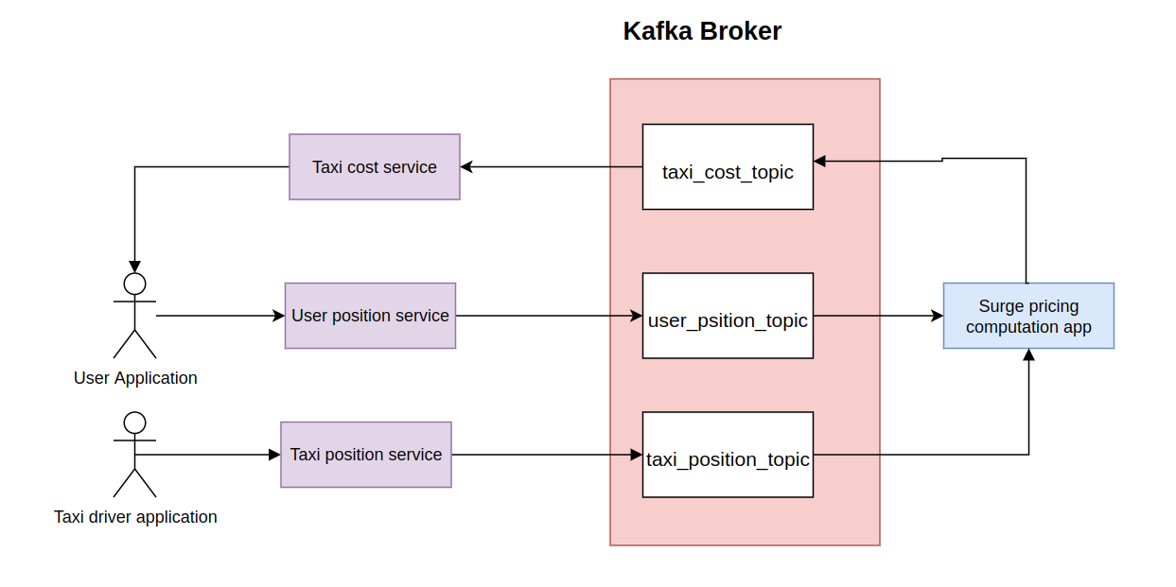
Review question solution

Slide 38




RabbitMQ
https://www.rabbitmq.com/
RabbitMQ was written in Erlang
Open sourced by Rabbit Technologies Ltd (now vmware) in 2007 and as of today is maintained by vmware
Licensed under the Mozilla public license
The project had been stared :10k times and forked 3.7k times
RabbitMQ is used by AT&T ,Cisco, Reddit ,American Airlines and more

Slide 39
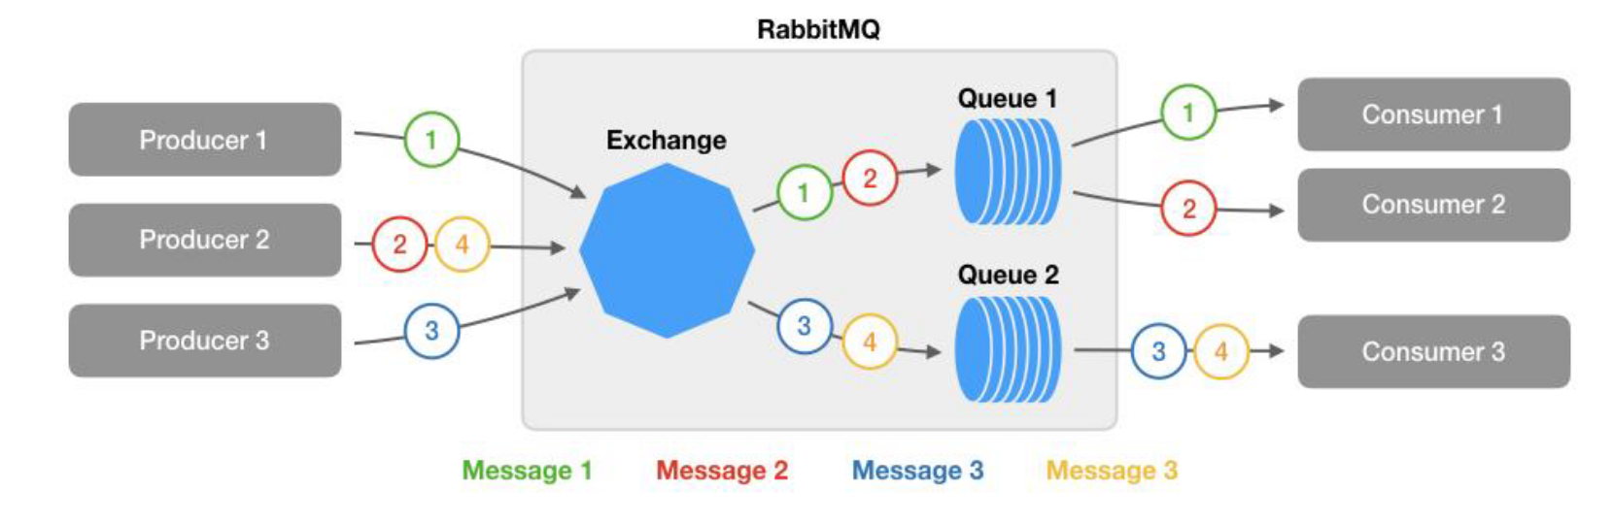
RabbitMQ Architecture

Slide 40
RabbitMQ Architecture
Producers
They write data to the RabbitMQ broker
They can attach key to the sent messages
Consumers
Consumers read data from the RabbitMQ broker
They read data from specific queues

Slide 41
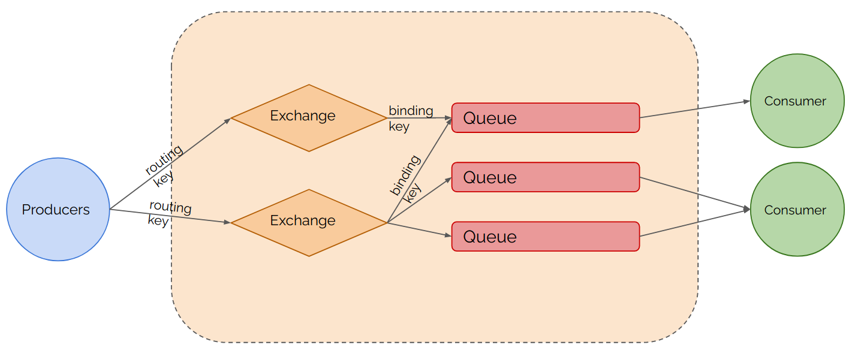
RabbitMQ Architecture
Broker
Receives messages from producers and sends them to consumers
Brokers are composed of the following:
Exchange
Queues

Slide 42
RabbitMQ Exchange & queues
Exchange
Part of the broker
Exchanges receiver messages directly from producers
Exchanges send messages to queues
Exchanges can be “bound” to queues
Queue
Part of the broker
Exchanges receiver messages from ezhanges
Consumers read data from queues

Slide 43
RabbitMQ Exchange distribution models
Exchanges can send messages to queues using different strategies
Fanout: Simply routes a received message to all queues that are bound to it. Ignores routing key
Direct: Routes a received message to the queue that match “rounting-key”. Nameless exchange is a “direct” exchange.
Topic: Routes a received message to queues, where binding key (defined as a pattern) matches to the routing key. Example, binding-key: “*.logs.error”, routing-key: “aplication1.logs.error”

Slide 44
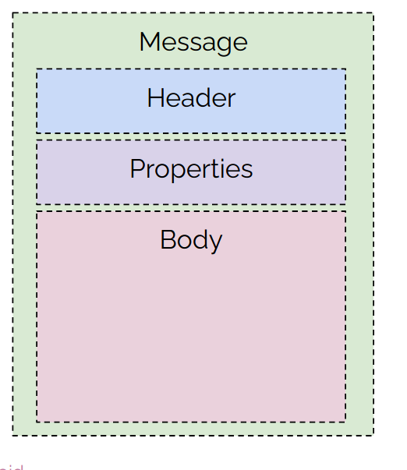
RabbitMQ Messages
RabbitMQ natively works with the AMQP protocol
RabbitMQ also supports other protocols such as AMQT,STOMP
Message limit is 2GB

Slide 45

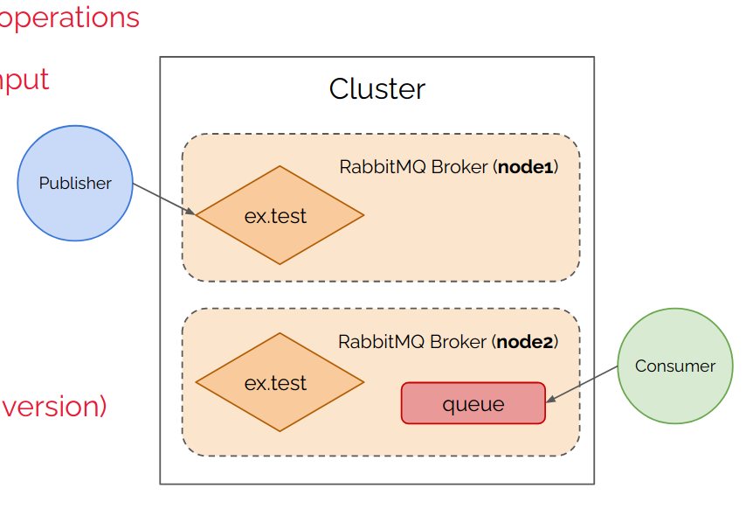
RabbitMQ cluster mode
RabbitMQ is natively built with cluster mode
There are couple different types of cluster modes:
Classic Queue Mirroring(deprecated):
Quorum Queues

Slide 46
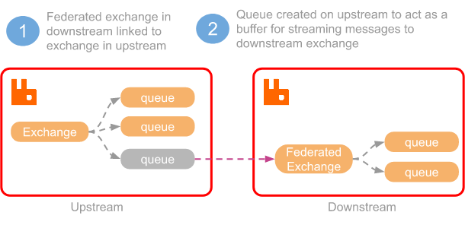
RabbitMQ Multi clustering
RabbitMQ allows communication between clusters using federation mode
This mode is basically upstreaming and downstream of messages across data centers

Slide 47
RabbitMQ Persistence and Durability
Durability
AMQP property for queues and exchanges. Messages in durable entities can survive server restarts, by
being automatically recreated when server gets up.
Persistence
Messages property. Stored on disk in special persistency log file, allowing them to be restored once
server gets up. Persistence has no effect a non-durable queues.
Persistent messages are removed from a durable queue once they are consumed (and acknowledged).

Slide 48
RabbitMQ message delivery models
There are 2 delivery semantics in RabbitMQ:
At most once
Messages are sent from producers to consumers
Message arrival is not verified
Message arrival is guaranteed to not have duplicates
At least once
Messages arrival is verified with ack
Messages might have duplicates

Slide 49
RabbitMQ advanced features
RabbitMq supports “smart” queues options
Priority queues:
Messages can be sent with priority
Values range from 0 to 10
Dead Letter Queues(DLQ)
Used for storing poison messages
Delayed queues:
Not an actual type but can be implemented using TTL for messages with DLQ

Slide 50
Review question
GetTaxi is a company that allows people to match with tax drivers on demand,right away
The business wants the following capabilities:
The user should match with a close by driver
The pricing should “surge” if the number of drivers are low or the number of users is high
All the position data before and during the ride should be stored in an analytics store so that the cost can be computed accurately
How would you implement this using RabbitMQ?

Slide 51
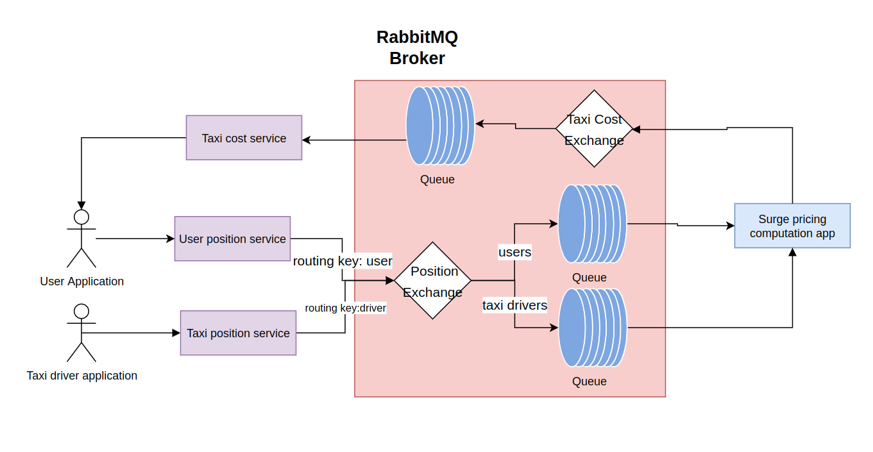
Review question solution

Slide 52




Nats.io
https://nats.io/
Nats was written in Go
Nats was Open sourced by Synadia in 2011 and as of today is maintained by Synadia(also me)
It is part of the CNCF
Licensed under the Apache 2.0
Nats comes in two versions: core and jetstream
The project had been stared :11.7k times and forked 1.1k times
Nats is a simple and lightweight alternative to RabbitMQ and Kafka
Nats is used by companies such as Alibaba, Ericcson, Tinder and Tesla

Slide 53
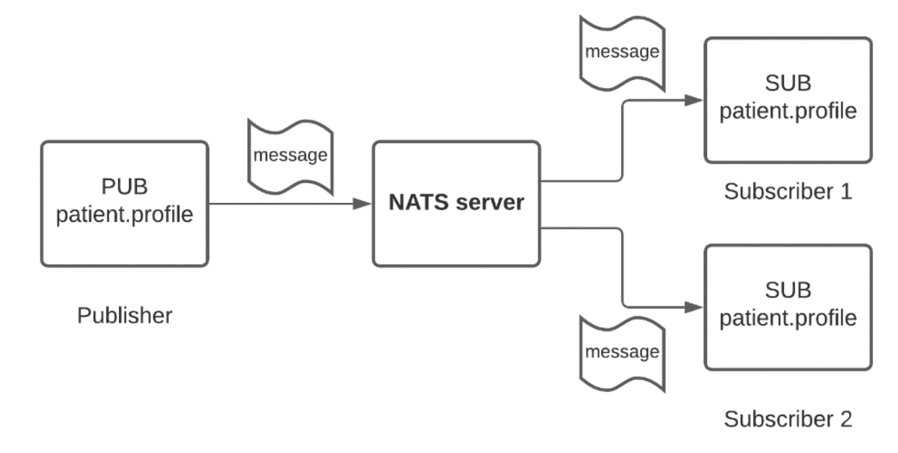
Nats.io Architecture

Slide 54
Nats.io Architecture
Producers
They write data to the Nats.IO broker
Producers write data to a specific subject or token
Consumers
Consumers subscribe to subjects
Consumers read data from the broker
Broker
Connects to producers and consumers using native golang channels
Receive messages from producers and sends them to consumers

Slide 55
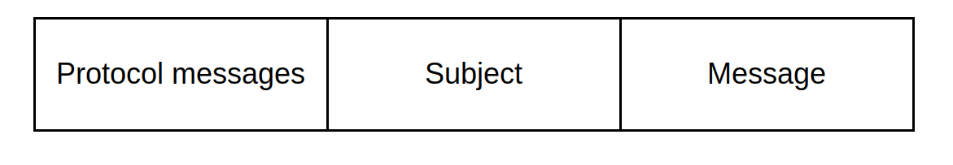
Nats.io Architecture: subjects
Messages in Nats.io between producers and consumers are sent to a nats-broker
Each message must have a subject
At its simplest, a subject is just a string of characters that form a name which the publisher and subscriber can use to find each other. It helps scope messages into streams or topics
Messages are sent as binary over tcp
Messages order of sending and receiving is guaranteed
Each message in of the following format:

Slide 56
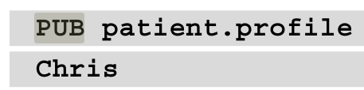
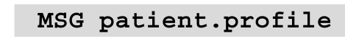
Nats.io Architecture: subjects
For example a publish message:
For example a subscription message:

Slide 57
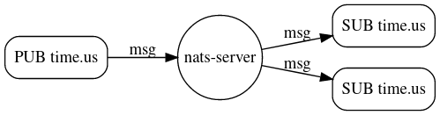
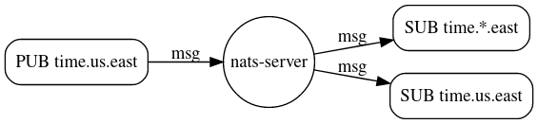
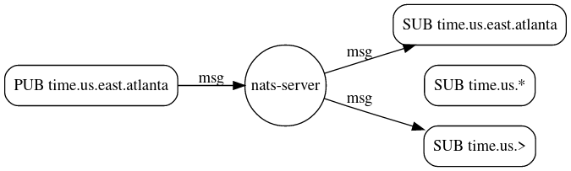
Nats.io Architecture: subjects
Subjects can be either of the following:
Exact names: such as PUB time.us
Wilds cards matching a single token
Wilds cards matching multiple tokens

Slide 58
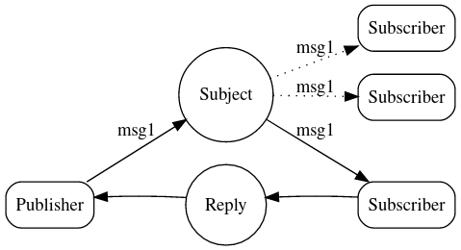
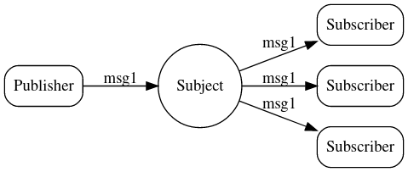
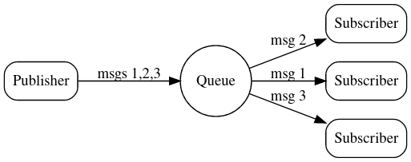
Nats.io message paradigms
Using its messaging format and smart routing capabilities Nats.io is capable of using the following message sending paradigms:
Publish-Subscribe:
Request-Reply:
Queue groups

Slide 59
Nats.io message delivery models
There are 1 delivery semantics in Nats.io core:
At most once
Messages are sent from producers to consumers
Message arrival is not verified
Message arrival is guaranteed to not have duplicates
If Jetsteam mode is enabled them Nats.io also has the following semantic::
At least once
Messages arrival is verified with ack
Messages might have duplicates

Slide 60
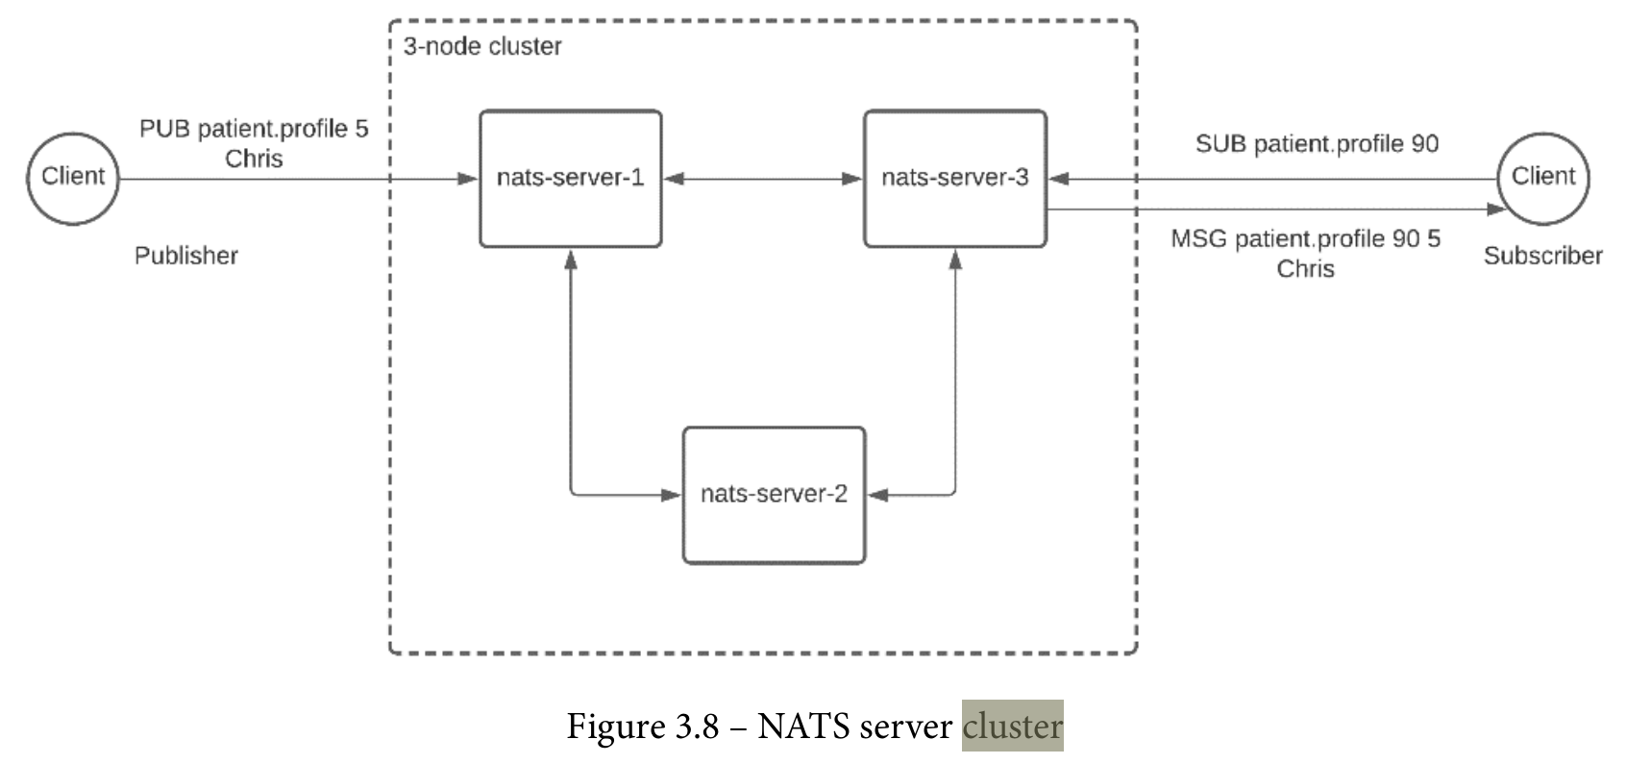
Nats.io Clustering
Cluster mode
Nats.io supports clustering mode
Nodes can be connected inside a network to create a cluster
Each node can forward messages to one adjacent node
Clustering in quorum based

Slide 61
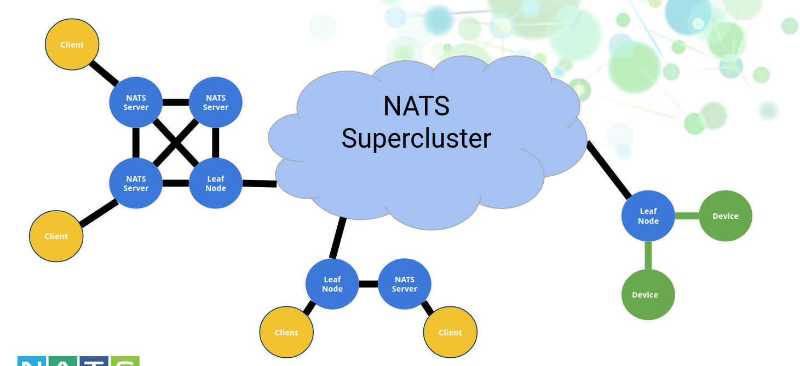
Nats.io Clustering
Super Cluster mode
Nats.io also support a super cluster mode(cluster of clusters)
Super cluster has different node types:
Broker
Gateway
Leaf Node

Slide 62
Review question
GetTaxi is a company that allows people to match with tax drivers on demand,right away
The business wants the following capabilities:
The user should match with a close by driver
The pricing should “surge” if the number of drivers are low or the number of users is high
All the position data before and during the ride should be stored in an analytics store so that the cost can be computed accurately
How would you implement this using Nats.io?

Slide 63

Review question solution

Slide 64
Kafka vs RabbitMQ vs Nats.io Features
Features | Kafka | RabbitMQ | Nats.io
Language developed in | Scala | Erlang | Go
Started In | 2011 | 2007 | 2011
Popularity | 23.4k stars | 10.1k stars | 11.7k starts
Open source license | Apache 2.0 | Mozilla public license | Apache 2.0
Messaging paradigms supported | pub/sub Message queue | pub/sub Message queue | pub/sub Message queue Request- reply
Message protocols | Binary over TCP/IP | AMQP, STOMP, MQTT | TCP/IP,MQTT,Websocket
Message size max | 1 MiB | 2 GiB | 1 MiB
Message Delivery | At most once At least once Exactly once | At most once At least once | At most once At least once

Slide 65
Kafka vs RabbitMQ vs Nats.io
Features | Kafka | RabbitMQ | Nats.io
Language support | 17 | 30 | 40
Message Storage | Disk | Disk In memory | Disk In memory
Distribution units | Topics | Quese | Channels
Clustering | Supported | Supported | Supported
Super clustering(clusters of clusters) | No-Supported | Not-Supported | Supported
Quality of documentation | High | High | Medium
Ease of use | Hard | easiest | Easy
Ease of installing and maintaining | Low | High | High
Docker image size | 443MB | 231MB | 12.3MB

Slide 66

Kafka vs RabbitMQ vs Nats.io Performance
Calculating performance for each broker might is not straight-forward
Each broker container many modes which can impact performance
In this section we will show the performance results of kafka vs RabbitMQ vs Nats.io under different scenarios
In the article “Performance evaluation of message-oriented middleware” the performance is measured
The testing was done on the following hardware:
We will explain use the results of this article

Slide 67


Kafka vs RabbitMQ vs Nats.io Performance: throughput graphs

Slide 68


Kafka vs RabbitMQ vs Nats.io Performance: latency graphs

Slide 69
Kafka vs RabbitMQ vs Nats.io Performance: summary
Scenario | Kafka |  | RabbitMQ |  | Nats.io
64B | Throughput | Latency | Throughput | Latency | Throughput | Latency(when no persistent otherwise it is worst)
8B | Best | Worst | Worst | Medium | Medium | Best
64B | Best | Worst | Worst | Medium | Medium | Best
512B | Best | Worst | Worst | Medium | Medium | Best
4096 | Worst | Worst | Best | Medium | Medium | Best
32768B | Medium | Worst | Best | Medium | Worst | Best
1048000B | Worst | Worst | Best | Medium | Medium | Best

Slide 70

Conclusion-what to use?
Is persistence important?
What size of message will the system use?
Should the system focus on throughput or latency
Is being lightweight important?
Can messages be lost?

Slide 71
Bonus questions

